Slide 1
360-degree feedback software for the Government of India related News Stories in Regional Media using Artificial Intelligence / Machine Learning
CSE7101- Capstone Project
Review-3
Batch Number: CAI_7
Roll Number | Student Name
20221CAI0010 20221CAI0052 20221CAI0065
CHANDREYI AVIJIT GHOSH
KEERTHANA B
SARAH FAROOQUI
Under the Supervision of,
Dr. Afroz Pasha
Professor
School of Computer Science and Engineering
Presidency University
Name of the Program: CAI
Name of the HoD: Dr. Zafar Ali Khan N
Name of the Program Project Coordinator: Ms. Suma N G
Name of the School Project Coordinators: Dr. Sampath A K , Dr. Geetha A

Slide 2
Content
Problem Statement
Project Overview and Objectives
System Architecture and Workflow
Component Details and Implementation
Output
Timeline of the Project
Git-hub Link
References

Slide 3
Problem Statement Number: PSCS-35
Organization: Ministry of Information and Broadcasting
Category: Software
Objective: Create a 360-degree feedback software for the Government of India to monitor news, analyze public sentiment, and provide actionable insights using AI/ML…
Challenges:
Managing large volumes of multilingual news data
Real-time sentiment analysis and feedback generation
Ensuring accuracy and bias-free insights
Secure handling of sensitive government data
Goal: Enable efficient news monitoring and informed decision-making for the Press Information Bureau (PIB)

Slide 4
Project Overview and Objectives
This project develops a comprehensive media monitoring platform for the Government of India leveraging diverse sources (websites, e-newspapers, and YouTube) using advanced AI/ML. Objectives:
Automate the collection and analysis of government-related news and feedback.
Cover multiple regional languages and media types.
Deliver actionable insights for timely, data-driven government decisions.

Slide 5
System Architecture and Workflow
Updated System Architecture: Provide a detailed diagram and description of the system architecture, reflecting any changes or optimizations made since Review 2. Include:
High-level architecture diagram (e.g., components, data flow, and interactions).
Any new components, modules, or integrations added.
Technologies, frameworks, or tools adopted or modified.
Workflow: Describe the workflow of the system, including:
How data or processes flow through the system.
Updates to workflows based on implementation progress or feedback.
Any automation or optimization introduced.
Scalability and Performance Considerations: Discuss how the architecture supports scalability, performance improvements, or fault tolerance, with specific examples of enhancements made since Review 2.

Slide 6
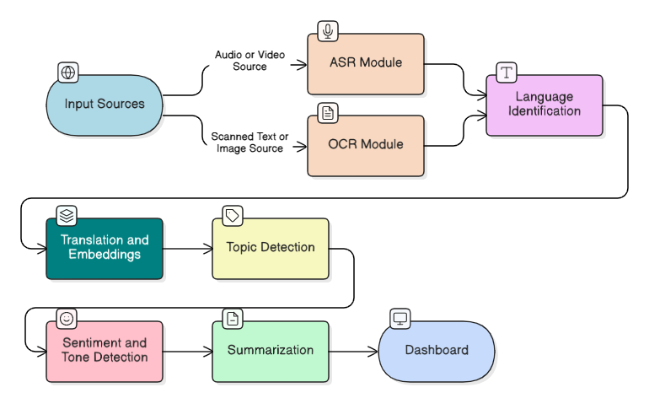
Module Level Design

Slide 7
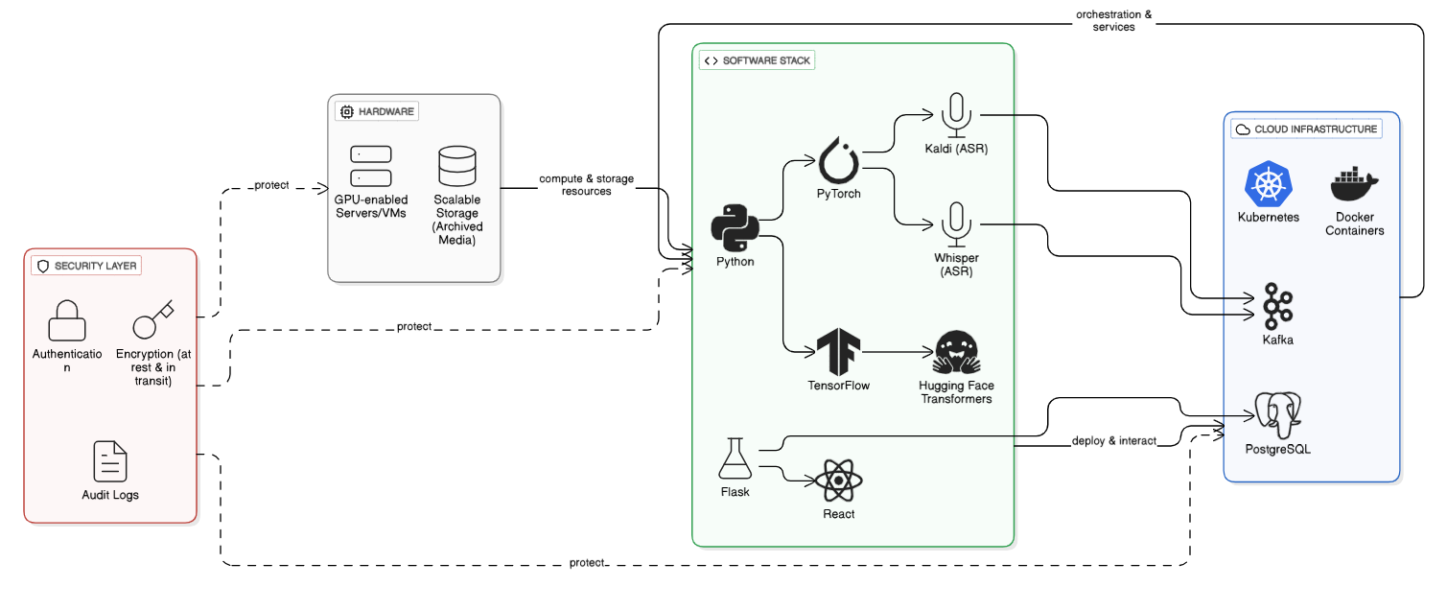
Unit Design

Slide 8
Component Details and Implementation
1.System Components (Overview)
The system follows a modular, microservice-based design, where each task is handled by a dedicated component.
All services are containerized using Docker and managed via Kubernetes for scalability.
Data flows through a structured pipeline: Ingestion → Processing → NLP Analysis → Storage → Dashboard.
Integrated features: real-time alerts, strong security measures, and human-in-loop feedback for continuous improvement.
2.Data Ingestion
Web Crawlers (BeautifulSoup, Scrapy) automatically scrape articles from regional news sites.
E-papers are collected as PDFs/images and passed to OCR for text extraction.
YouTube Data API retrieves video content, metadata (titles, descriptions), and audio streams.
All raw data is standardized into JSON format with metadata tags (source, date, language).
This ensures uniformity for downstream processing modules.

Slide 9
Component Details and Implementation
3.Language Identification
Uses lightweight transformer-based models to detect both language and script.
Supports Hindi, Bengali, Kannada, and English, with scalability for more Indian languages.
Each input is assigned a confidence score to ensure accurate downstream processing.
Enables fallback to multi-model pipelines if uncertainty is high (e.g., code-mixed content).
4. Modality Processing
Automatic Speech Recognition (ASR): YouTube audio is transcribed using Whisper/Kaldi for multilingual speech.
Optical Character Recognition (OCR): Tesseract or custom OCR extracts text from e-papers and scanned PDFs.
Text Extraction: Cleans news articles by removing ads, boilerplate, and formatting noise.
Converts all data types into plain text format, ready for normalization.

Slide 10
Component Details and Implementation
5.Text Normalization
Applies Unicode normalization to maintain text consistency.
Handles code-mixed text by transliteration (e.g., Hindi words in English script).
Removes stop words, unwanted characters, and performs basic tokenization.
Ensures standardized and clean text input for embedding and NLP modules.
6.Translation & Embedding Layer
Neural Machine Translation (NMT): Converts non-English text into English for uniform analysis.
Multilingual Embeddings (LaBSE, IndicBERT, XLM-RoBERTa): Generate semantic representations of text.
Embeddings allow semantic search, clustering, and similarity detection across languages.
Maintains traceability by linking translated outputs back to the original source language.

Slide 11
Component Details and Implementation
7.NLP Core Services
Topic Detection: Classifies content into categories like Politics, Health, Education, etc.
Sentiment & Tone Analysis: Detects polarity (Positive, Negative, Neutral) and evaluates tone (critical/supportive).
Summarization: Provides concise summaries of long articles or transcripts (extractive with option for abstractive).
Outputs are structured with labels, summaries, and metadata, enabling quick insights.
8. Storage & Indexing
PostgreSQL: Stores structured metadata (titles, authors, dates, tags).
Elasticsearch / OpenSearch: Enables semantic search, trend analysis, and analytics dashboards.
S3-compatible storage: Archives original raw text, transcripts, and article scans for long-term access.
Designed for scalability, redundancy, and compliance with government IT standards.

Slide 12
Component Details and Implementation
9.Dashboard & Alerts
Developed in ReactJS, optimized for non-technical PIB officers.
Features: filters by date, department, sentiment, and language.
Provides visual analytics: sentiment trends, charts, tables, and keyword highlights.
Real-time alerts (Email/SMS/API) trigger when negative sentiment spikes or urgent issues arise.
Ensures fast, informed decision-making for stakeholders.
10.Human Feedback & Security
Human-in-the-loop corrections: Analysts can edit transcripts, sentiment tags, or summaries.
Feedback loop helps retrain AI models for higher accuracy over time.
Security Features:
End-to-end encryption (TLS in transit, AES-256 at rest).
Role-Based Access Control (RBAC) for authorized use.
Full audit logging to track every action and modification.
Ensures compliance with privacy, legal, and ethical guidelines.

Slide 13
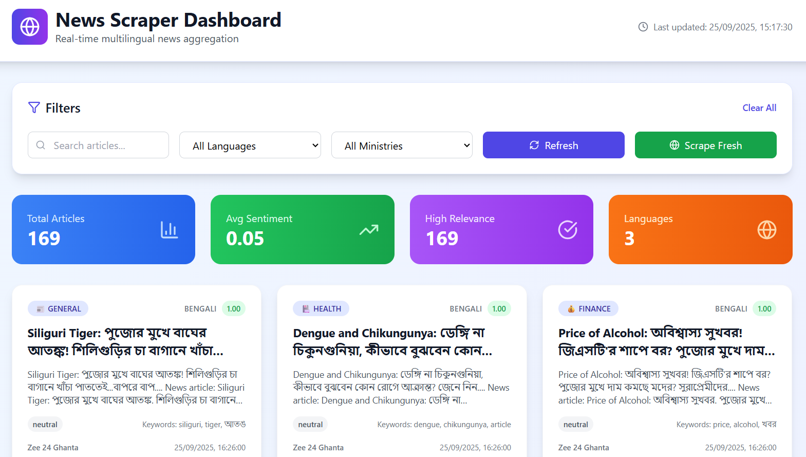
OUTPUT

Slide 14
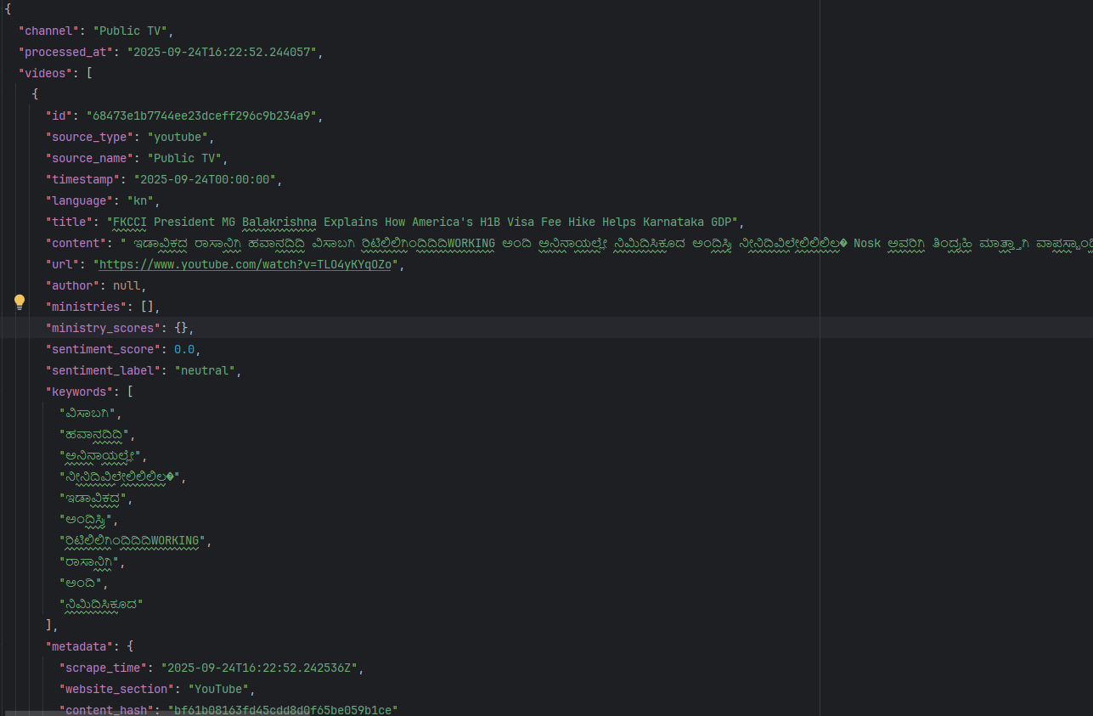
OUTPUT

Slide 15
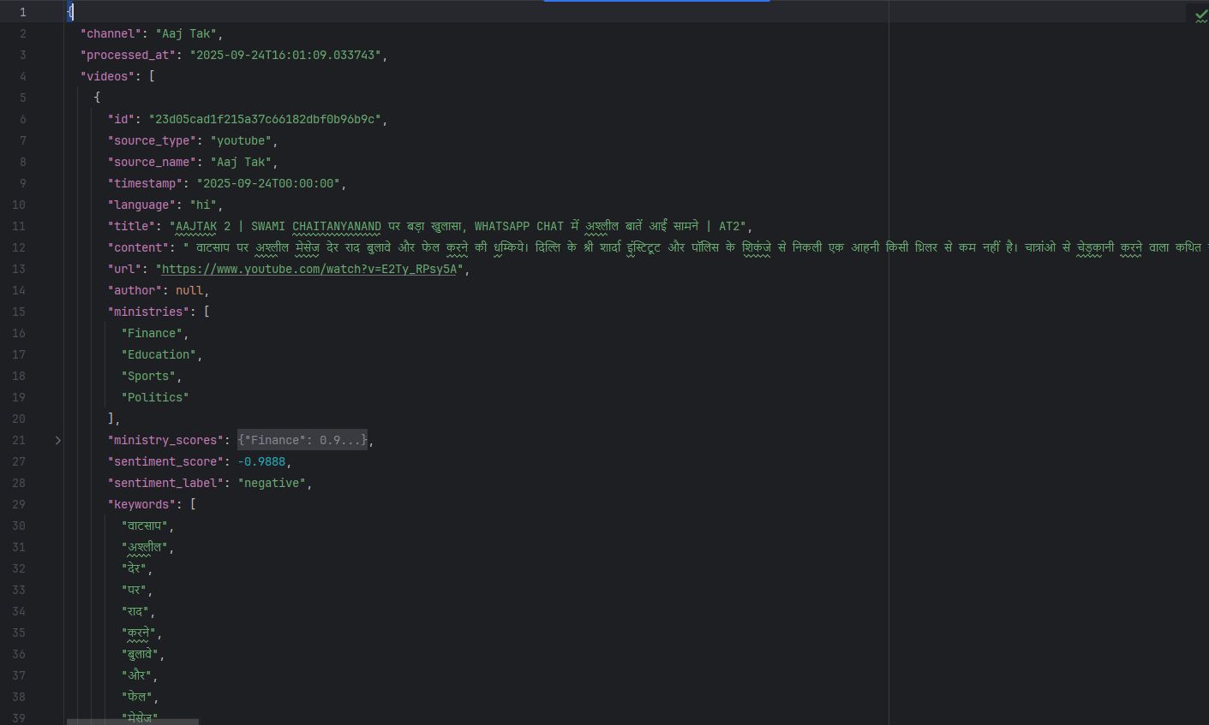
OUTPUT

Slide 16
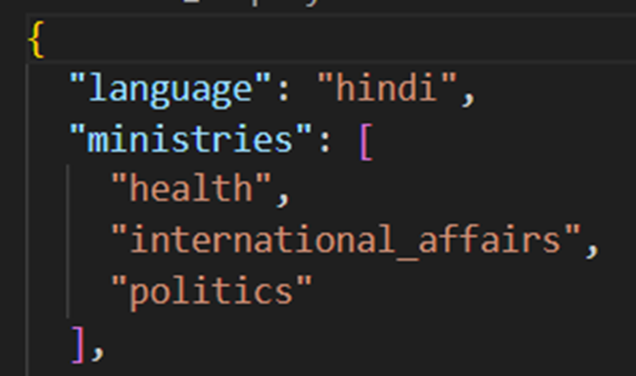
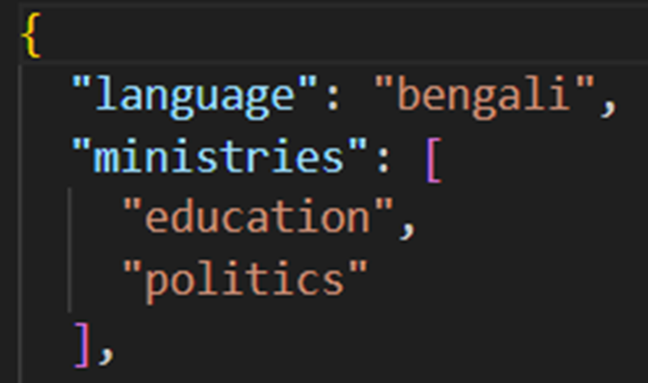
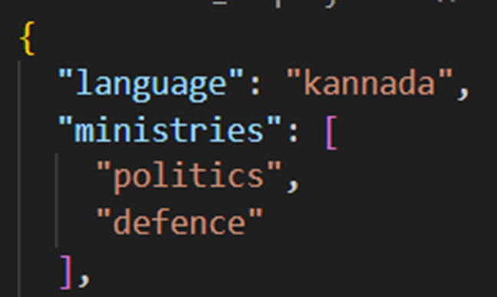
OUTPUT

Slide 17
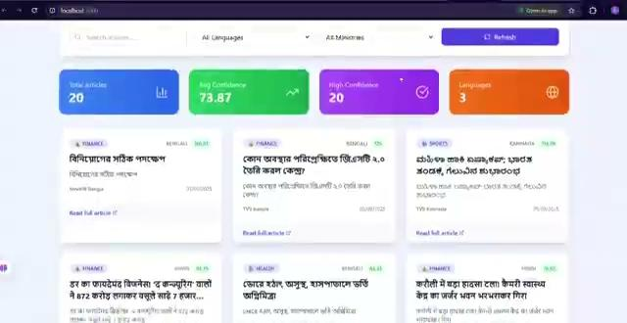
OUTPUT

Slide 18
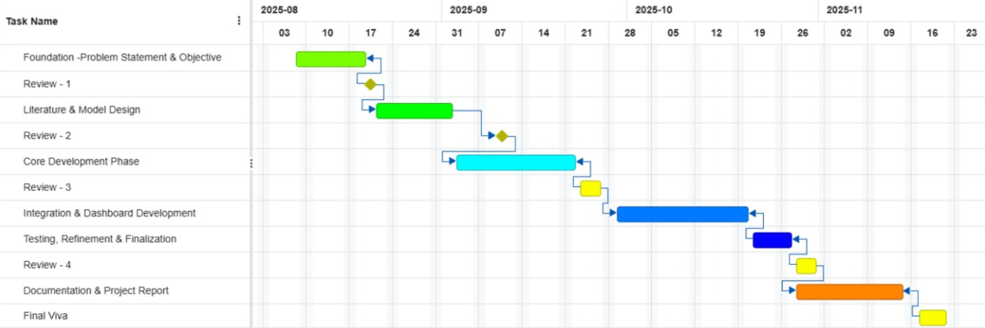
Timeline of the Project (Gantt Chart)

Slide 19
Github Link
The Github link provided should have public access permission.
Github Link

Slide 20
References (IEEE Paper format)
[1] K. S. Kumar, D. S. Rajput, B. S. S. Raj, and R. S. Raj, "360-degree feedback software for the Government Press Information Bureau (PIB) using artificial intelligence and machine learning," *Int. Res. J. Mod. Eng. Technol. Sci.*, vol. 6, no. 5, pp. 714–720, May 2024. [Online]. Available: Link
[2] K. S. Kumar, D. S. Rajput, B. S. S. Raj, and R. S. Raj, "360-degree feedback software for the Government Press Information Bureau (PIB) using artificial intelligence and machine learning," *Res. Gate*, May 2024, doi: 10.13140/RG.2.2.12131.14880. [Online]. Available: Link
[3] Vorecol Team, "The role of artificial intelligence in enhancing 360-degree feedback processes," *Vorecol Blog*, 2024. [Online]. Available: Link
[4] K. S. Kumar, D. S. Rajput, B. S. S. Raj, and R. S. Raj, "360-degree feedback software for the Government Press Information Bureau (PIB) using artificial intelligence and machine learning," *Int. Adv. Res. J. Sci. Eng. Technol.*, vol. 11, no. 4, pp. 714–720, 2024. [Online]. Available:
Link
[5] S. M. Alblwi, A. A. Almazroi, M. Alqarni, H. Alqahtani, and A. Albesher, "A review of 360-degree feedback as a tool of leadership competency development," *Appl. Sci.*, vol. 13, no. 3, p. 1445, Jan. 2023, doi: 10.3390/app13031445. [Online]. Available: Link

Slide 21
References (IEEE Paper format)
[6] D. I. Ivanova and A. V. Sokolov, "360-degree feedback: Automation using natural language processing," in *Proc. CEUR Workshop*, vol. 3159, 2022, pp. 1–8. [Online]. Available: Link
[7] A. V. Sokolov and D. I. Ivanova, "Automation of 360-degree feedback processes in organizations using natural language processing," *Procedia Comput. Sci.*, vol. 178, pp. 350–357, 2020, doi: 10.1016/j.procs.2020.11.037. [Online]. Available: Link
[8] K. S. Kumar, D. S. Rajput, B. S. S. Raj, and R. S. Raj, "360-degree feedback software for the Government Press Information Bureau (PIB) using artificial intelligence and machine learning," *Int. J. Adv. Res. Sci. Commun. Technol.*, vol. 4, no. 5, pp. 714–720, May 2024. [Online]. Available: Link
[9] "Sentiment analysis of tweets in three Indian languages,"
[10] "Sentence opinion mining model for fusing target entities in official government documents,"
[11] "NAAC SSR document," Dr. Babasaheb Ambedkar Marathwada Univ., 2023. [Online]. Available: Link

Slide 22


